Slide 1
Shift2Rail Info Day Call for Proposals 2017

Slide 3
reference framework
S2R Regulation
S2R Master Plan
S2R Multiannual Action Plan
S2R Annual Work Plans

Slide 4
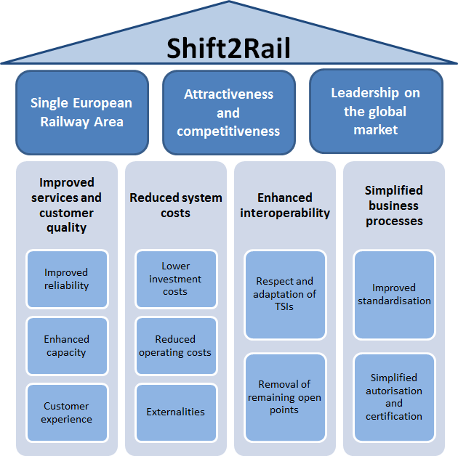
key objectives
Single European Railway Area
Attractiveness and competitiveness of the European railway system
Leadership on the global market

Slide 5
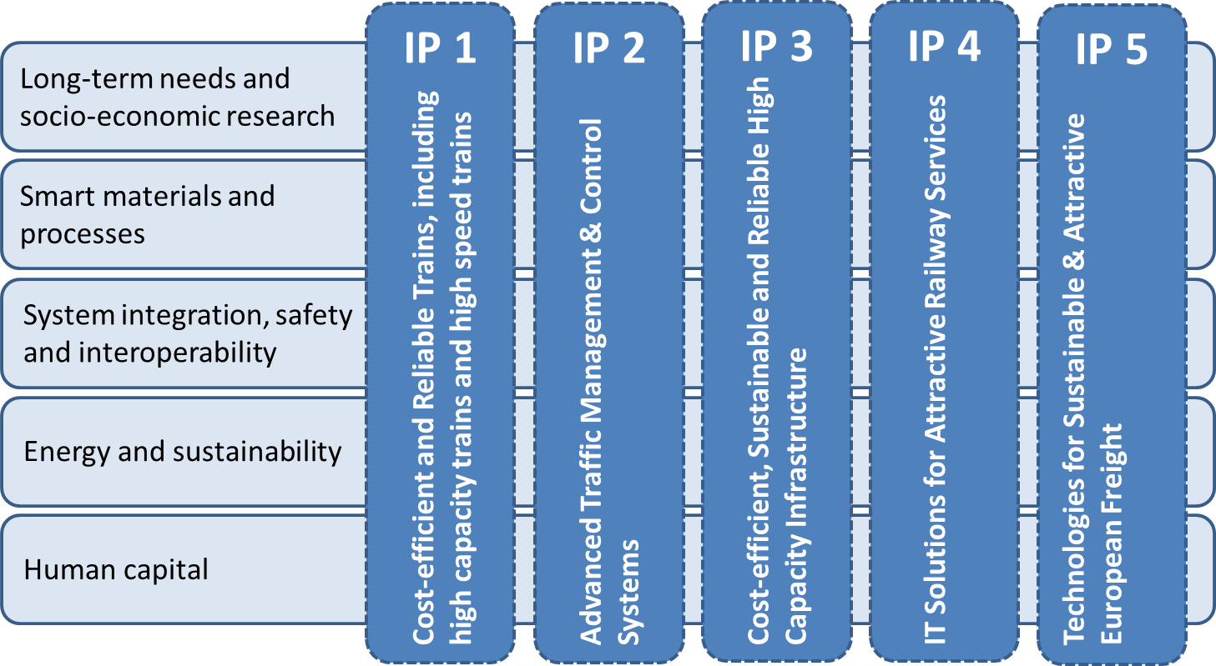
Innovation Programmes

Slide 6
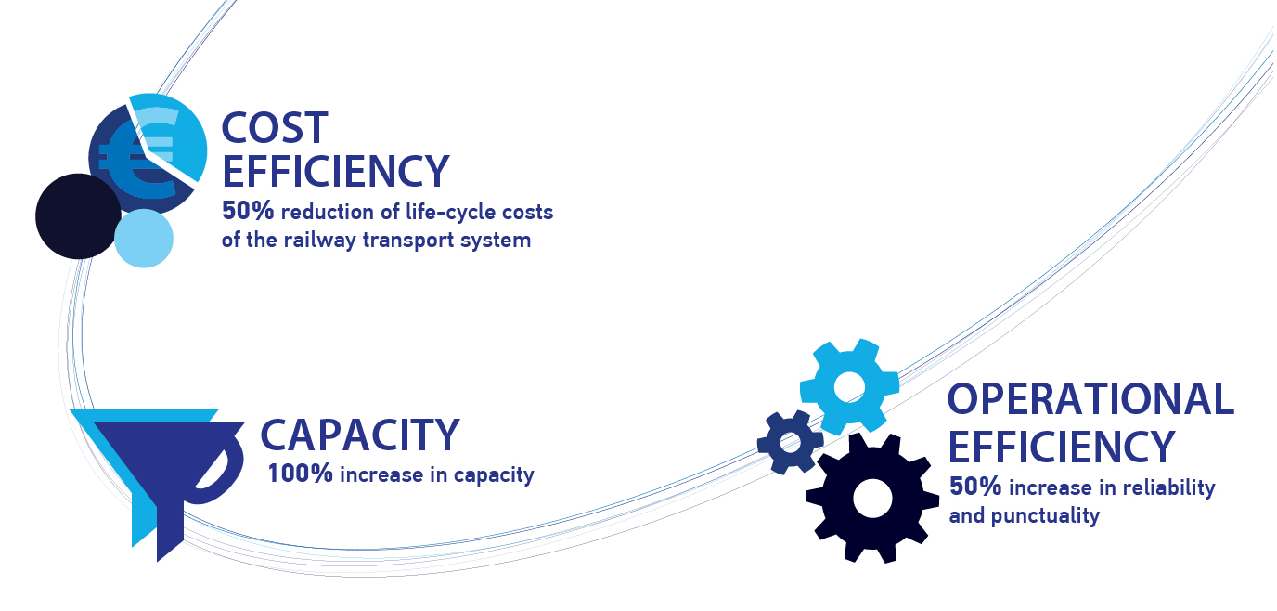
what is S2R
A public-private partnership, a platform for the rail sector as a whole to work together to drive innovation in the years to come.
Objectives for 2024:
Council Regulation (EU) No 642/2014 of 16 June 2014 (S2R Regulation)

Slide 7
a new approach to R&I
a. Overcome R&I fragmentation
b. Support the market uptake
c. Implement innovative solutions
Focused, coordinated, LT investment in R&I
Stakeholders sustained networks and knowledge exchange
System-wide approach to innovation
Operational performance & cost-effectiveness
Increase leverage effect of EU funding

Slide 8
an open organization
8 Founding Members having committed at least EUR 30 million for the duration of Shift2Rail, to secure substantial industry co-funding from the outset
19 Associated Members selected as a result of a call representing a broad range of actors from the entire rail value chain and from other innovative sectors, including SMEs, research organisations, universities, etc.
at least 30% of the Union contribution through calls for non-JU members

Slide 10
members
European Union
8 Founding Members | Alstom, Ansaldo STS, Bombardier, Construcciones y Auxiliar de Ferrocarriles (CAF), Siemens, Thales and infrastructure managers Trafikverket and Network Rail
12 Associated Members (single legal entities) | Amadeus IT Group, AZD Praha, Deutsche Bahn, DIGINEXT, Faiveley Transport, HaCon Ingenieurgesellschaft, INDRA Sistemas, Kapsch CarrierCom, Knorr-Bremse, MER MEC, SNCF Mobilités, Patentes Talgo
7 Associated Members (consortia) | AERFITEC (AERNNOVA Aerospace, FIDAMC, Fundacion TECNALIA) Competitive Freight Wagon (Contraffic, DLR, Waggonbau Niesky, Centro de Estudios e Investigaciones Técnicas (CEIT), Verband der Bahnindustrie in Deutschland) EUropean Rail Operating community (Infraestruturas de Portugal, BLS, CP, Finnish Transport Agency, ÖBB-Infrastruktur, Polskie Koleje Państwowe, PRORAIL, Schweizerische Bundesbahnen, Slovenske zeleznice, Türkiye Cumhuriyeti Devlet Demiryollari) Smart DeMain (Strukton Rail, ACCIONA Infraestructuras, DLR, Fraunhofer, CEMOSA) SmartRaCon (DLR, CEIT, Fondation Railenium, Nottingham Scientific Ltd) Swi'Tracken (Fondation Railenium, Universidade Do Porto, Universidad Del Pais Vasco, Universidade Do Minho, TATASTEEL, VOSSLOH-COGIFER, Institut für Zukunftsstudien und Technologiebewertung, EGIS RAIL, Groupe EUROTUNNEL, TRONICO ALCEN) Virtual Vehicle Austria consortium+ (Kompetenzzentrum, FCP Firtsch, Getzner Werkstoffe, Kirchdorfer Fertigteilholding, Plasser&Theurer, Vvoestalpine Schienen, Voestalpine VAE, Wiener Linien, AVL List, PJM Messtechnik, TATRAVAGONKA, AC2T research, Materials Center Leoben Forschung

Slide 11
programme financials
IPs 777 M
IP1
225M
IP2
195M
IP3
153M
IP4
86M
IP5
83M
CCA
35M
IKAA 163M
Other 27M
Values as at 1 Sept 2016 in Million EUR
Programme 967M
S2R (H2020)
Co-Fin 450M
Railway Sector Net
Contribution 517M

Slide 12
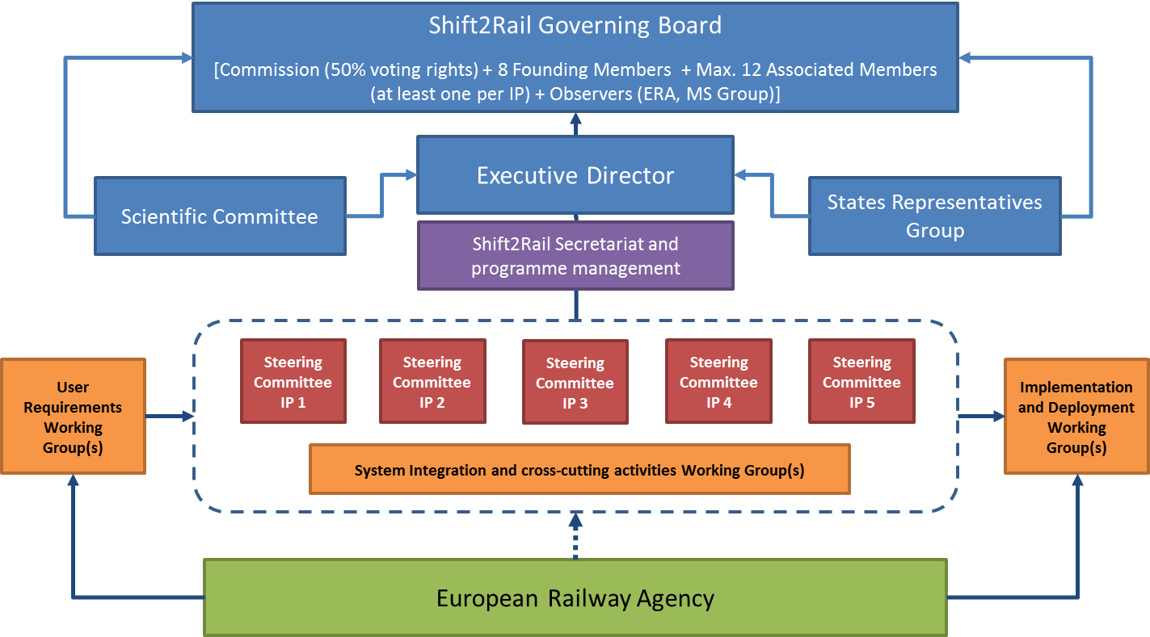
governance
System Integration and Cross-Cutting Activities Working Group(s)
European Union Agency for Railways

Slide 13
Thank you for your attention

