Slide 1
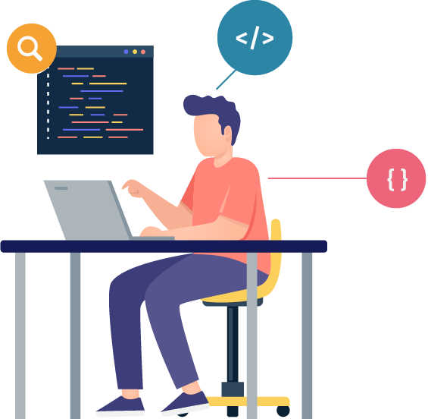
Join our Hackathon as a partner!
Hack 2 Rail
23 – 24 October 2021

Slide 2
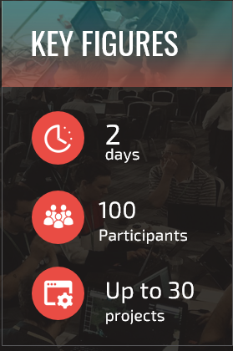
Hack 2 Rail event details
Date: 23-24 October 2021 + Demo day on 29 October 2021
Objective: Generate innovative ideas / use cases to accelerate the digital revolution of
Passenger Rail
Rail Freight
Target audience: Startups from across Europe and different disciplines
Concept: A 2-day design hackathon where multi-national & multi-disciplinary teams of developers, entrepreneurs, designers etc. brainstorm innovative solutions to respond to 4 challenges (2 passenger and 2 rail freight related challenges) by submitting their project on the BeMyApp platform (specialised hackathon company subcontracted by Shift2Rail)
Prizes: 10,000 EUR + opportunity to work with Siemens / other member companies on Proof of Concept

Slide 3
Hack 2 Rail challenges

Slide 4
Hack 2 Rail – Passenger challenges
Digital revolution of Passenger Rail
1. Passenger and Staff Experience
How can we make the passenger information systems on platforms and trains more accurate? In which coach do passengers have more chances to have a seat, which are the less occupied coaches, how could this information be delivered to passengers and staff in an efficient way?
How can we access and deliver information for disabled and elderly people?
How can we make the work for the staff on the platform / in the trains / stops easier and more efficient? How can we deal with passenger requests concerning connections for example? How can we ensure staff know how many passengers will get-in/get-out at the next stop, and how difficult checking tickets will be?
2. Bringing new life to stations and stops
In order to attract more passengers, provide innovative ideas on how to optimize the space in stations or create a new concept for multimodal hubs: optimising the use for logistics, open office space for working, studying, etc.

Slide 5
Hack 2 Rail – Freight challenges
Digital revolution of Rail Freight
Freight is usually transported by different means (train, truck, etc.). Especially during reloading, failure occurs.
1. From road2rail
How can we incentivize the end customer to use rail freight rather than road transportation?
E.g. professional tool/dashboard to estimate CO2 vs. cost vs. quality based on route and goods. The CO2 emission depends on how much freight/how many passengers are on the train (in real time) and how is the energy mix of the network for the train (in real time). How could we calculate the overall energy consumption and emission effect personalized per passenger / per trip / per cargo unit (per package / per ton) as well as in total per train / per fleet / per country)?
How can the usage of rail freight become more attractive for the end customer (shippers, logistics)?
2. Transparent and efficient planner for freight
How could a planner for freight look like?
How can transport be operationally and commercially optimized and how can we create more transparency for the end customers? Time of arrival, reliability, trip-tracking, ensure door-to-door delivery, etc.
How can we foster and develop mid rail transport among consumers and SMEs by optimizing capacity and making better use of the available space in rail freight?

Slide 6
Hack 2 Rail – project management
3-step process
STEP 1 | Hackathon concept & design
(6 weeks):
Format: Defining 4 challenges, establishing the target audience, the prizes, finalising the timeline
Platform: setup, activation of features, customisation
Stakeholder onboarding: mentors, jury, coaches, partners
Content creation: website, communication content & resources
STEP 2 | Communication & Outreach
(8 weeks):
Several push and pull communication actions for targeted recruitment of relevant profiles to take part in the hackathon.
These actions will be initiated by BeMyApp using the wide and relevant networks they have access to (hackathon communities), and complemented by communication through Shift2Rail, Siemens & other partners.
STEP 3 | Hackathon Programme (1.5 weeks):
Opening Week (1 week): Webinars providing introductory & expert information on the challenges. By end of week all participants submit an idea on how they will solve their chosen challenge. The organisers will then select the most promising ideas/teams to take part in the hackathon.
Hackathon (2 days): Participants work towards submitting their prototype/mock-up with help from mentors (experts from partner companies) and BeMyApp coaches.
Final Demo Day (½ Day): The top submissions will present their work in front of a jury, and the winners will be selected.

Slide 7
Hack 2 Rail timeline

Slide 8
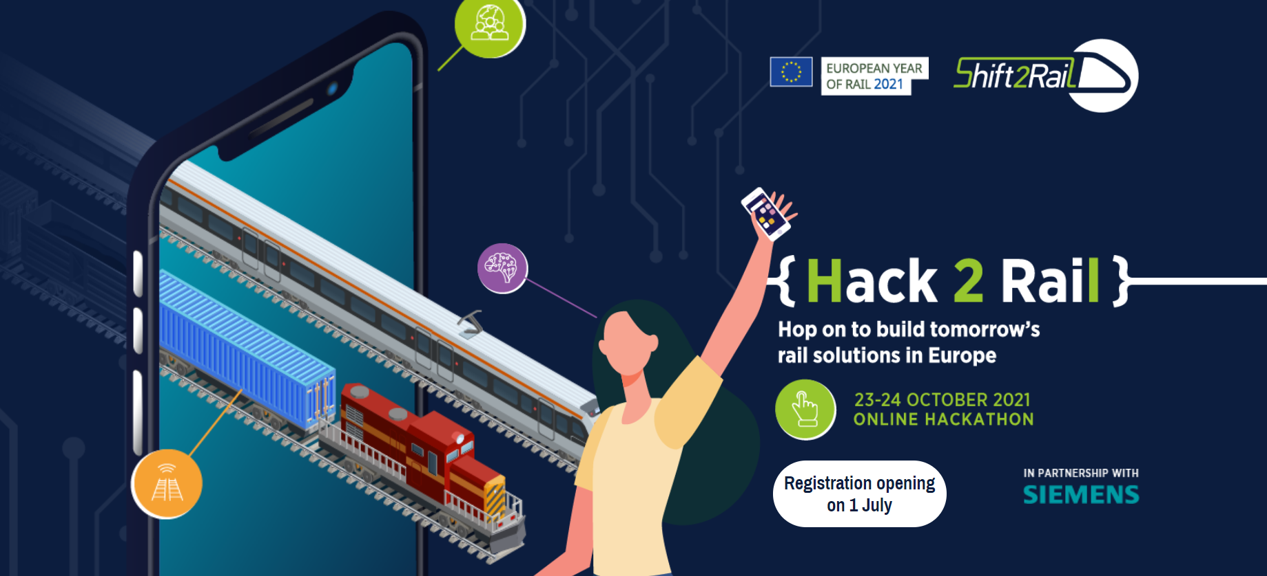
Hack 2 Rail Website – https://hack2rail.shift2rail.org

Slide 9
Participants’ Registration
Registration opens on 1 July!
Teams made up of 2 to 5 people will be able to register
from 1 July – 3 October 2021.

Slide 10
Join us as a partner!
This is a joint Shift2Rail and Siemens initiative, open to other S2R members who would like to become partners.
All you need to do is:
Provide experts to serve as mentors and/or jury members
Mentors should share their experience, knowledge and expertise of their field, inspire participants and represent his or her company. Mentors will need to guide the participants before and during the hackathon on 23-24 October
Jury members should have an expertise in a field related to the hackathon, interest in the event and understand the start-up mind-set. Jury members will need to select the best ideas during the virtual demo day on 29 October
Join as a partner – express your interest by 25 June!
See innovative ideas developed during the hackathon
Exposure to a large group of targeted media, technology thinkers and makers

Slide 11
The mentors’ mission
Inspire participants
Challenge their ideas
Share personal experiences, expertise and knowledge of the company
Guide teams’ thought processes and help them refine their ideas
Answer participants’ questions, being proactive and approachable
Select the finalist teams

Slide 12
Mentors’ Agenda
4
Event platform
Hackathon
Selection #2
Selection #1
04-22 October (TBC)
5 min per day
Answer participants’ questions in the chat
13 October (TBC)
2H
Select 3-6 teams/ challenge
23-24 October
2 mentoring sessions (slots TBD)
+
Mentoring on-demand (if available)
24 October
Select the 10 finalists

Slide 13
The Jury’s mission
THE JURY’S MISSION
Before the final demos: Jury briefing
Attending a 30-min briefing to get familiar with the criteria, the theme, the other jury members, the rating grid
During the final demos: Rating
Evaluating the potential of each project
Asking questions during the Q&A session
After the final demos: Deliberation
Debriefing during a 30-min meeting
Agreeing on the winners

Slide 14
Call to Action!
Join us as a partner by 25 June to have your company logo included on the Hack 2 Rail website before the Registration Launch on 1 July!
Contact the Shift2Rail Communication Team (communication@s2r.europa.eu)

